Slide 1
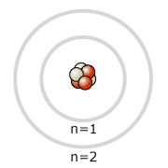
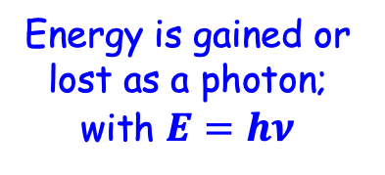
The Bohr model
Because only specific colours/photon-energies are emitted, Niels Bohr proposed the following model for an atom:
(i) Only orbits of specific radii are
permitted for electrons in an atom
(ii) An electron in a permitted
orbit has a specific, fixed energy
(iii) Energy is only emitted or
absorbed by an electron
when it jumps from one
allowed energy state
to another
The paths are called orbits
Quantization!
Energy is gained or
lost as a photon; with $E=hν$
The ground state = the lowest energy state
An excited state is any one with higher energy
Energy levels in an atom are quantized the same way that light is. Photoemission occurs as an electron relaxes from a higher energy state to a lower energy state.

Slide 2

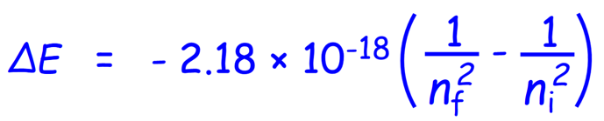
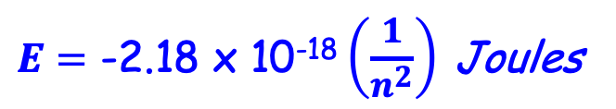
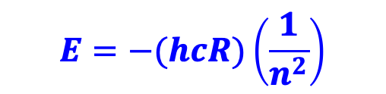

The electron can move from any one fixed energy levels to another one
Electron moves to lower energy as light is emitted
Results in a line spectrum particular to each element
n = $∞$
n = 5
n = 4
Quantized electron energy for a hydrogen atom (only) is given by:
n = 3
Recall:
$$E=−(hcR)\left(\frac{1}{n^{2}}\right)$$
n = 2
h = Planck’s constant
C = speed of light
R = Rydberg constant
n = energy level
$E=$ -2.18 x 10⁻¹⁸ $\left(\frac{1}{n^{2}}\right)$ Joules
n = 1
Electron moves to higher energy as light is absorbed
Notes:
Should add Rydberg’s name here

Slide 3
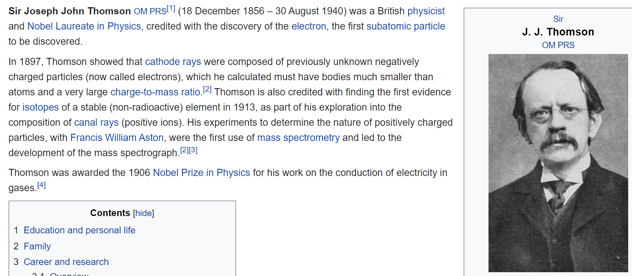
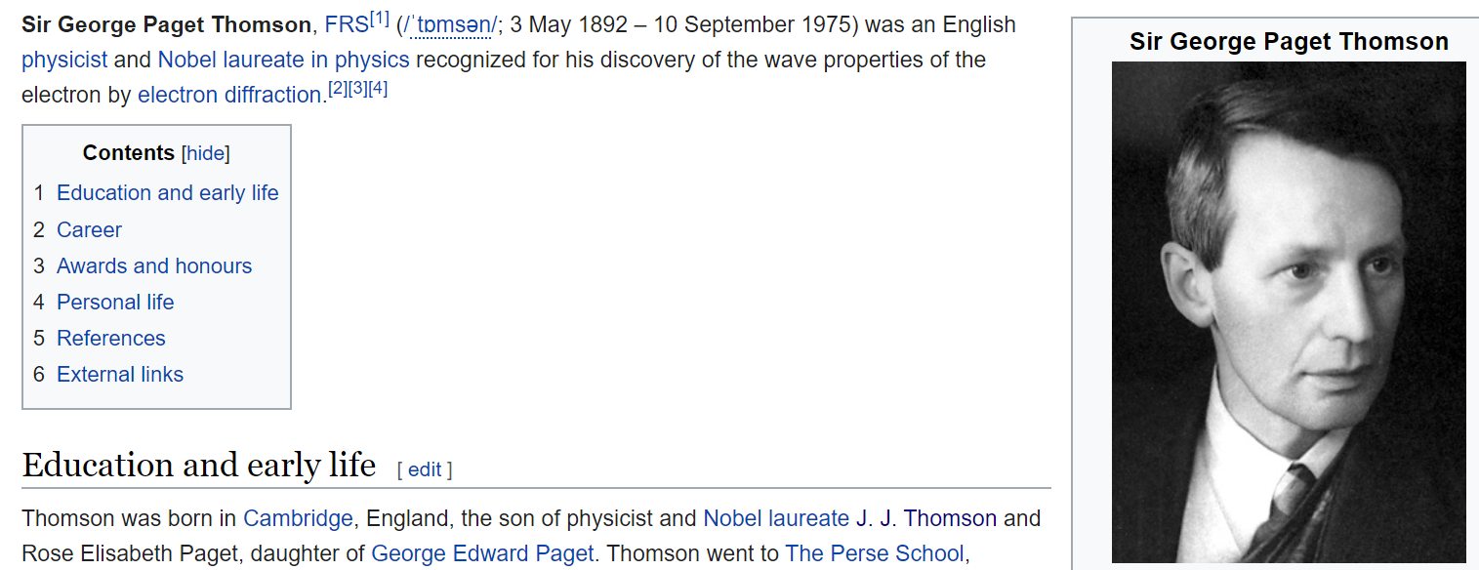
Discovers a fundamental, sub-atomic particle: the electron
His son:
Discovers that an electron acts like a wave !!!
Notes:
Slides with grey background not for printing in lecture book

Slide 4
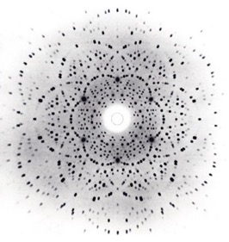

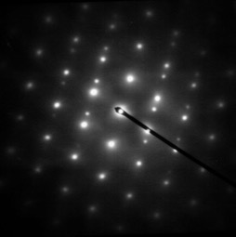
Electrons can Interfere with Each Other
A grid of atoms (a crystal) can diffract a beam of electrons, just like they do a beam of X-rays
Detector
Beam of X-rays
crystal
Detector
Beam of Electrons
crystal
Notes:
https://en.wikipedia.org/wiki/Electron_diffraction#/media/File:Austenite_ZADP.jpg

Slide 5
Development of Quantum Theory
Louis de Broglie first proposed that if light can have material properties, all matter must exhibit wave properties.
He proposed that the characteristic wavelength of the electron or of any other particle depends on its mass, m, and on its velocity, v:
The momentum, p = mv, is a particle property, whereas λ is a wave property
λ = h / mv = h/p
Extensive experimental evidence backs up de Broglie’s hypothesis.
Applicable to all matter but for objects of ordinary size, the calculated wavelength is unimaginably short and has no noticeable effect
Electron microscopes use electrons in place of the light beam: they have higher resolution because the electron’s wavelength is incredibly short

Slide 6

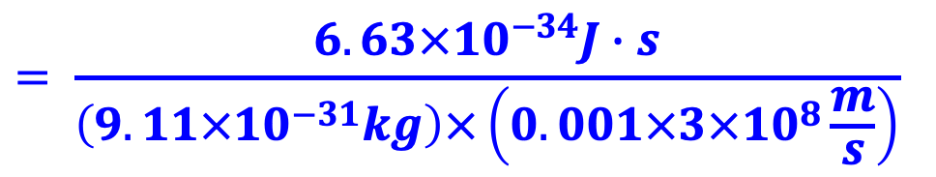

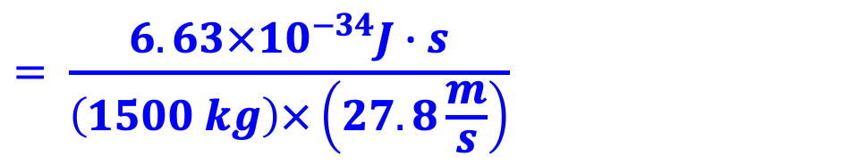
De Broglie Wavelength Examples
Example 1: Wavelength of an electron travelling at 0.1 % the speed of light:
$$= \frac{6.63×{10}^{−34}J∙s}{\left(9.11×{10}^{−31}kg\right)×\left(0.001×3×{10}^{8}\frac{m}{s}\right)}$$
~10 He atoms !!
h / p = h/mv
$$=2.4 nm$$
λ =
Example 2: Your car travelling at 100 km/hr:
$$= \frac{6.63×{10}^{−34}J∙s}{\left(1500 kg\right)×\left(27.8\frac{m}{s}\right)}$$
h / p = h/mv
$$=1.6×{10}^{−38}m$$
λ =
Way smaller than your car !!
> Car doesn’t appear to act like a wave

Slide 7



Particles as Waves: Unexpected Effects
Imagine shaking an extension cord up and down to make a standing wave; or instead, giving it a quick snap to make a travelling wave:
Momentum: easy, comes from wavelength
Position: ??? Wave is everywhere, not in one place
Position: pretty clear where wave is
Momentum: ??? what would wavelength be?
Werner Heisenberg’s Uncertainty Principle: we cannot know the exact position AND exact speed of a subatomic particle because that is the nature of waves
Δx • Δ(mv) ≥ h / 4π
The more precisely we know x, the less we know mv ! (and reverse)

Slide 8

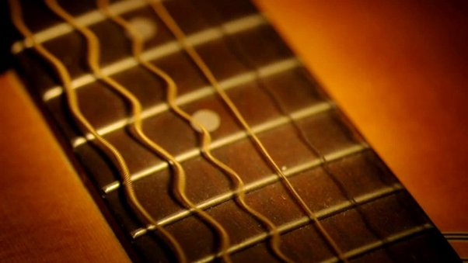
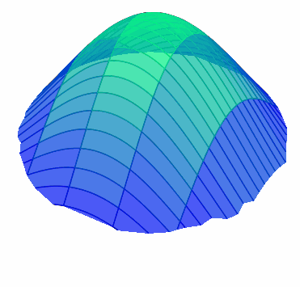
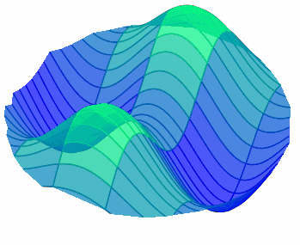
Not All Waves are Travelling: 1D and 2D Standing Waves
The lobes oscillate, but the nodes are fixed at zero
Wavelengths with any INTEGER # of lobes are possible
Plucking a guitar string yields a standing wave
node
node
node
node
Don’t need to plot time if we colour relative up/down: phase
2-Dimensional Standing Waves
(like a drum skin)
Relative
phase
1D slice of relative phase
Low frequency
Higher frequency
Don’t need time!
Notes:
Can visualize standing waves like the skin of a drum by putting salt on a plate: https://youtu.be/wvJAgrUBF4w?si=5Y0h-ykUpunYJ331&t=45
Might want to add: energy increases with # of nodes
All images generated in python, except for guitar that is NOT public, I took a screencap from youtube

